Slide 1



Slide 2
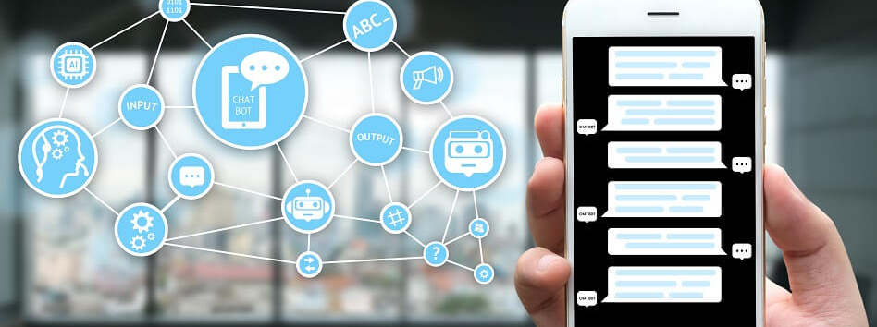
Welcome to Bots and Artificial Intelligence Meet Up
Presented By:
Phil Coachman (Cloud Solution Architect)
Priyanshi Singh (Data Scientist)
Madhu Chanthati (DEP)

Slide 3
Agenda:
Introduction to Chatbot
Department of Environmental Protection Demo
Chatbot Hands on

Slide 4
30,000,000+
messages per day
30,000+
active bots/month
300,000
developers
1,000+
companies

Slide 5




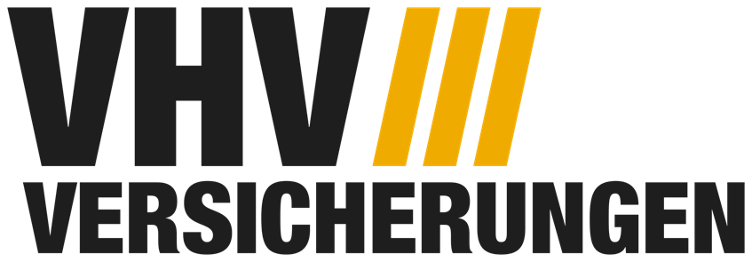


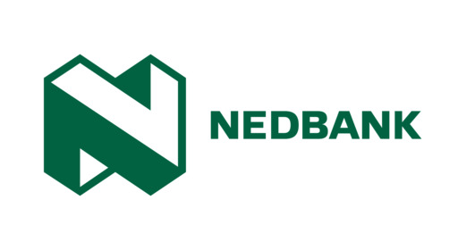

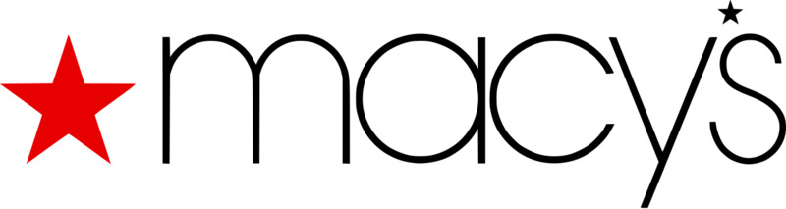





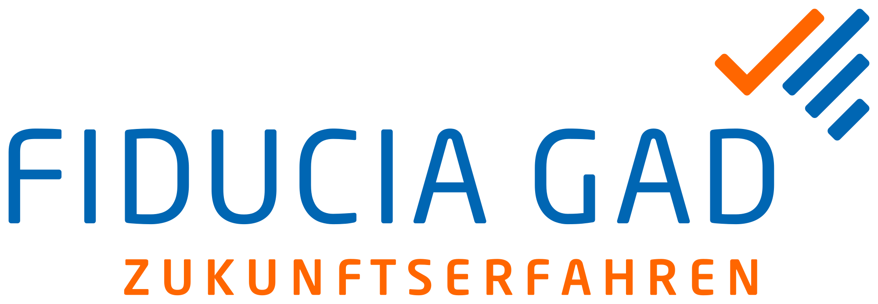




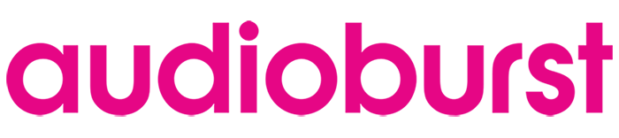
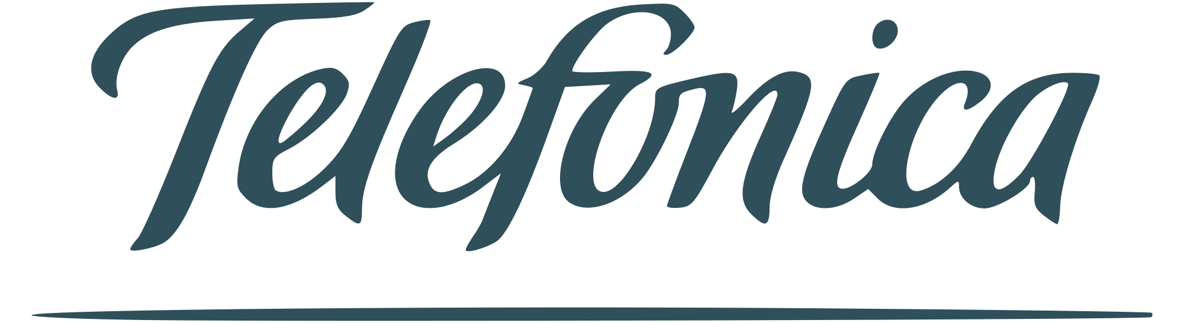
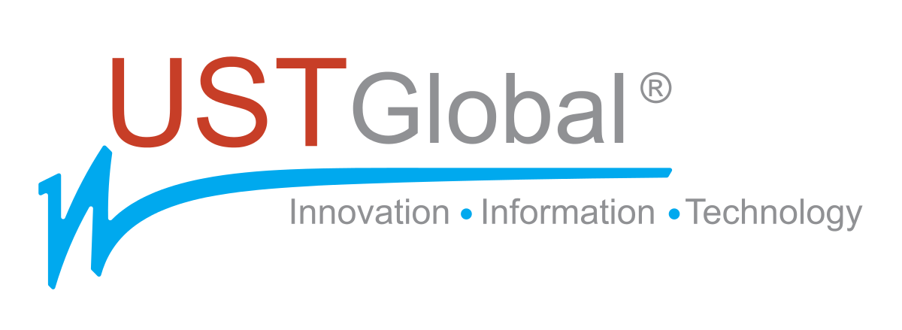
Conversational AI: 1000+ companies
More details: https://customers.microsoft.com
Notes:
Customer Support: How do you reduce friction for customers. How to help customers find information tends to be the most popular scenario. You offer some product or services, there are a set of common questions people email or call about. If you can democratize that with a conversational experience, it’s quicker and easier for customers to find the info typically resulting a higher customer satisfaction, and reduces the load for call centers to focus on the more complex tasks. So democratize finding info is one thing. Beyond that, what are the tasks, what ca the bot actually do to simplify the process for all parties involved. The ability to collect some information, fill out a form and contact you later with a response. All within the context of a conversation. That context can be authenticated. We know about you, so we know your name, your address, and we don’t need to ask you those info. For example, a product manual for an appliance or within a car.
There are more than 1,000 companies building with our toolkit, and here is a subset of these. These are just showing some of those that we have public case studies. We have many more that are internally facing.
We not only offered a platform and toolkit for building bots, but with Microsoft Services team, we have worked with customers around the world directly building these bots together, so a lot of the best practices we have learned that we will share in today’s session are based on those experiences.
Customer Support: How do you reduce friction for customers. How to help customers find information tends to be the most popular scenario. You offer some product or services, there are a set of common questions people email or call about. If you can democratize that with a conversational experience, it’s quicker and easier for customers to find the info typically resulting a higher customer satisfaction, and reduces the load for call centers to focus on the more complex tasks. So democratize finding info is one thing. Beyond that, what are the tasks, what can the bot actually do to simplify the process for all parties involved. The ability to collect some information, go ahead to fill out a form automatically and contact you later with a response. All within the context of a conversation. That context can be authenticated. We know about you, so we know your name, your address, and we don’t need to ask you those info. For example, a product manual for an appliance or within a car. You can find a product manual for an appliance If you ask what that red light or error code mean? A bot can take user through a set of choices around troubleshooting and guide through that conversation, Worst case if the bot cannot resolve the issue, it can then handover to a human, and the human can see the troubleshooting history, so the user does not need to repeat himself.
For example, Progressive Flo chatbot answers customer question and provides quotes. Telefonica launched Aura, their AI-powered digital assistant Aura, first in Argentina, Brazil Chili, Germany, Spain and UK, and ask about their bill, the services contracted, data usage, and other content.
Another one is retail – the ability to sell goods. We can unlock quite sizable product catalogue. Take the Dixon Carphone example in UK, they have more than 12,000 products, and a bot can help customers navigate through those products in a more natural way. It’s not about replicating just the search experience: you type some product name and range, and get few results, and can refine at the left for filters like brand, etc. You can just say: I’d like a Microsoft laptop and don’t want to spend more than $1500, and I’d like it to have a USD port and a HDMI port. So you can express a reasonably complex requirement, and the bot can understand and extract the relevant information, and provide you with the most relevant product recommendations. Instead of the typically broad and poor experience you get in some of the website based on keyword searching. So unlocking product catalogue, and adding to basket is one thing. Another one is guidance shipping experience - the ability to deliver a guided experience to help you choose a washing machine. You may not
Employee Productivty: reduce

Slide 6
Demo
Litware Insurance

Slide 7
A great bot provides a delightful user experience
Valuable
Address a real (or latent) need or solves a problem
Accessible
is easily accessible and available when and where the user needs it most
Effective
meets the need better, easier, faster than alternative experiences

Slide 8
Conversational AI Bot framework
Bot Builder SDK
Build and connect intelligent bots
Powerful, easy-to-use framework
Start quickly with samples and templates
Open source on GitHub
Azure Bot service
Accelerated development
Give your bot intelligence with Cognitive Services
Engage your audience, wherever they are
Channels
Connect your bot to Teams, Skype, Cortana, or other channels
Configure channels via Azure Bot Service
User discovery of bots

Slide 9




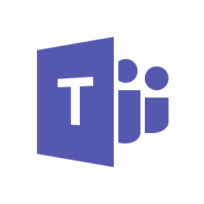
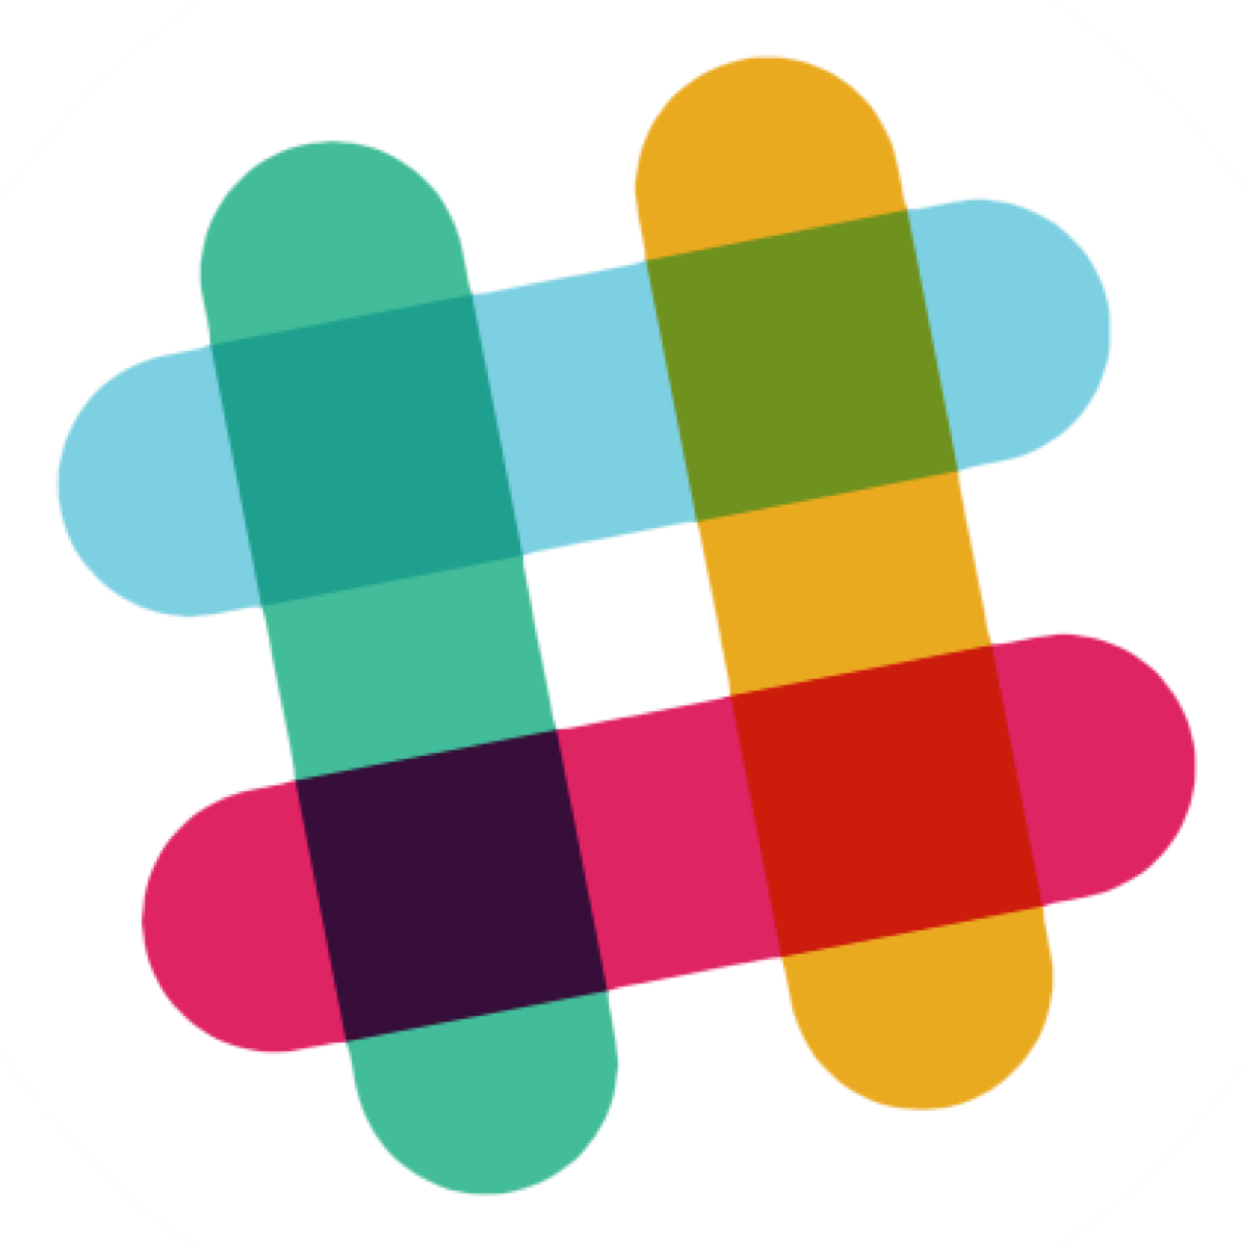

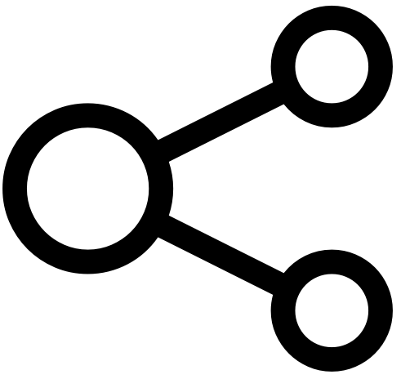

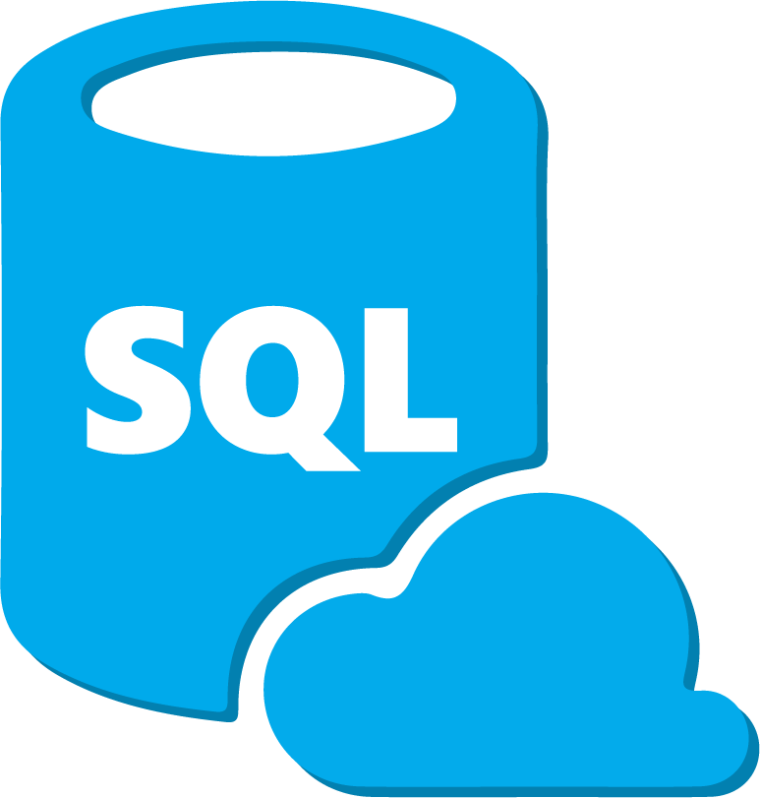


Conversational AI Azure Bot Service + Cognitive Services
User input
Channels
Bot intelligence
Business process
LOB apps
Bing Search
Start
Text
Transition 1
Transition 2
State 1
State 2
Speech
Transition 3
Transition 4
State 3
Bot Framework SDK Dialog Manager
Speech
On-premises
IFTTT
QnA Maker
Dispatch
Enterprise stores
Image
Translator
Language understanding
Azure Tools
Security
Logging
Auditing
Integration

Slide 10



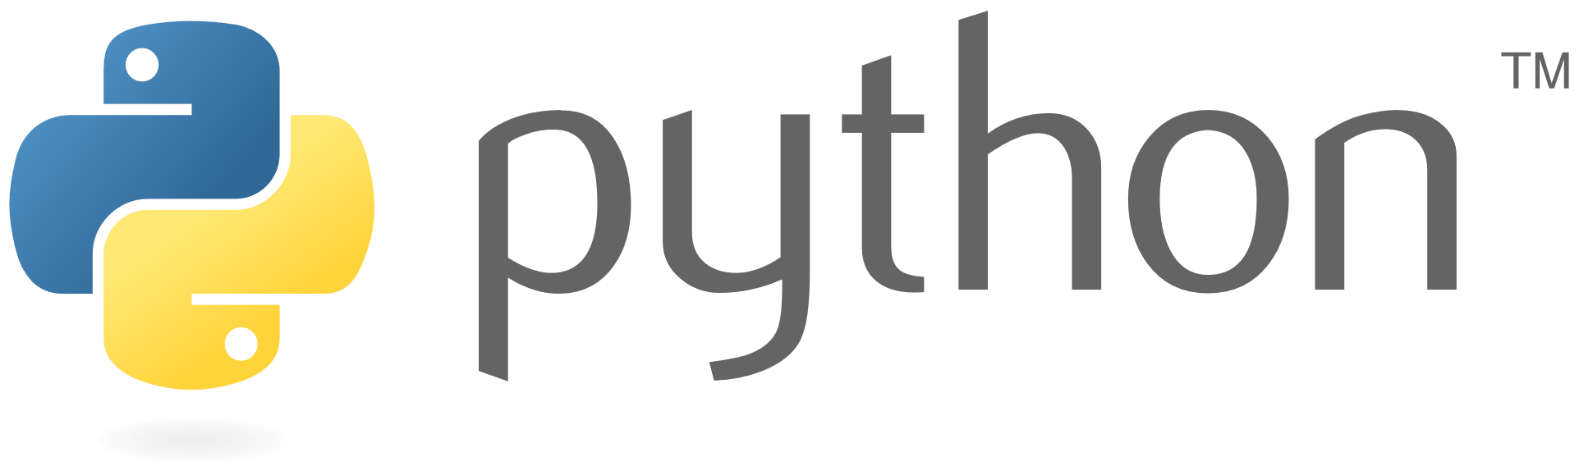
Building your bot
Step 1
Choose your platform
Step 2
Quickly get started
VSIX and Yeoman templates
Scenario focused samples
Commerce chatbot
Information chatbot
Enterprise chatbot
Step 3
Deploy your bot
Azure Bot Service
On-premises hosting
Hybrid hosting
… you have a working bot!

Slide 11
Demo
Echo Bot – Azure Bot Service

Slide 12
Author Dialogs
Design Cards
Visualize
Plan
Bot Builder SDK
Cognitive Services
Getting Started Templates
Build
Create a conversation with Bot Service
Emulator​
Application Insights
Emulator
Test
DevOps Tools
Azure
BYO Web Host
Publish
Comprehensive framework for the lifecycle of your project
WebChat, Cortana, Skype, FB
+
Custom (DirectLine)
Connect
Evaluate
Application Insights
LUIS Suggestions
Notes:
<Enter> <Enter> <Enter>
Here’s a simple E2E development workflow .. You want to start building your bot by creating mockup conversations. These will help you validate your scenarios as well as build out a rough skeleton of the types of conversations your bot needs to support. This is the phase where key business decision makers can collaborate and or review the mocks and approve.
<Enter>
As I was saying earlier, your bot itself is made up of parts. There are bunch of different parts that you need to build and integrate to build a good bot.
Including Language Understanding, Dialog, AI services, User Experience, Infrastructure and your own business logic.
There are bunch of different services and tools available for you to build your bot parts.
<Enter>
That said, with Bot Builder V4, for the first time we are covering the E2E bot development workflow. You will have powerful tools that help plug into each phase of your development. You can build on top of the tools to suit your own development style and preferences.
With the new tools we are also introducing several new simple text file formats that work in conjunction with the tools.
Of course to build your bot and assemble all your bot parts together, we have a fantastic new Bot Builder SDK.

Slide 13
Plan
Author Dialogs
Design Cards
Visualize
Bot Builder SDK
Cognitive Services
Getting Started Templates
Build
Plan
Emulator​
Application Insights
Emulator
Test
Comprehensive framework for the lifecycle of your project
DevOps Tools
Azure
BYO Web Host
Publish
WebChat, Cortana, Skype, FB
+
Custom (DirectLine)
Connect
Evaluate
Application Insights
LUIS Suggestions
Notes:
<Enter> <Enter> <Enter>
Here’s a simple E2E development workflow .. You want to start building your bot by creating mockup conversations. These will help you validate your scenarios as well as build out a rough skeleton of the types of conversations your bot needs to support. This is the phase where key business decision makers can collaborate and or review the mocks and approve.
<Enter>
As I was saying earlier, your bot itself is made up of parts. There are bunch of different parts that you need to build and integrate to build a good bot.
Including Language Understanding, Dialog, AI services, User Experience, Infrastructure and your own business logic.
There are bunch of different services and tools available for you to build your bot parts.
<Enter>
That said, with Bot Builder V4, for the first time we are covering the E2E bot development workflow. You will have powerful tools that help plug into each phase of your development. You can build on top of the tools to suit your own development style and preferences.
With the new tools we are also introducing several new simple text file formats that work in conjunction with the tools.
Of course to build your bot and assemble all your bot parts together, we have a fantastic new Bot Builder SDK.

Slide 14
How to design an experience?
Plan
1
Form a multi-disciplinary team
Build
2
Understand users to identify bot use cases
Test
3
Create bot measurement plan
Publish
4
Define bot persona
Connect
5
Design conversation flow
Evaluate
… and build the experience in parts; start simple and layer in sophistication

Slide 15
Conversation patterns
During the bot design process, we identified certain patterns for the type of conversations <Customer Name> bot will be able to support, these include:
One-turn intelligent response
Contextual guided assistance
Multi-turn process guidance
Multi-turn conversational task completion
Intelligent notification
One-turn FAQ
These are general FAQ style one-turn responses. QnA Maker engine can be utilized for model training as there is no backend integration required.
This is a notification pattern because it is not in response to any query initiated by the user. Design guidance suggests caution when it comes to the bot providing proactive notification. One use case we identified using this pattern is a personalized greeting which alerts the user if a critical action is holding up the intake process.
These are also one-turn responses which don’t typically have a follow-up or additional conversational flow. These are “intelligent” terms as they need to be provided within the context of an active student ID. For example, a student asking for their GPA information or other academic or account-related information which doesn’t typically require additional dialog. Machine learning-driven responses may also fall in this pattern.
In this scenario, context is associated with the page/URL the user is on as opposed to who the user is. <Customer Name> has a number of scenarios where a user needs to navigate a series of pages to complete a process (e.g., application enrollment, transfer credits, etc.) and would like the bot to be able to answer questions within this context. Since these are single turn and static question-answer pairs, QnA Maker can be utilized for this pattern.
This is a unique scenario within the <Customer Name> domain – there are a number of process flows established that a bot can be enabled to do a user walk-through. While these are multi-turn dialog scenarios, they are not truly conversational as the user responses are restricted to yes/no only with potentially an option to opt out or cancel the guided assistance.
This is a multi-turn conversational pattern typically leading to a task completion scenario. In this type of pattern, the user is not restricted to fixed responses and can potentially provide free-form natural language response. The bot will need to interpret this within the context of the process the user is in. Typical task completion use cases such as change address or reset password call into this category.
Increasing complexity
Notes:
Using Conversation Patterns as a complexity measure
While working on defining use cases, there is a varying level of complexity involved with certain types of conversational flows. For example, a one-turn dialog that is simply responding by pairing an answer to a question (or set of questions) is a low complexity use case as compared to a multi-turn dialog that needs to extract multiple entities, has to remain context sensitive and is doing some type of task completion which also requires backend integration is a high complexity use case. Then there are other patterns that fall somewhere in between these two extremes. To manage priorities across use cases and overall acceptance criteria for the project, within the constraints of the project scope, it is important to bring in a complexity discussion while we walk through the use cases.
One way we have managed these conversations in other engagements is by defining a set of conversational patterns that are organized by the level of complexity where each use case, as it is discovered, is mapped to one of those conversational patterns. There are some sample patterns available in the deliverables attached that can be used to manage the conversation. Please keep in mind that we have not yet landed on a universal set of conversational patterns and the ones available in the deliverables are based on specific customer scenarios. However, with little effort these patterns can be adjusted to map to other customers.

Slide 16
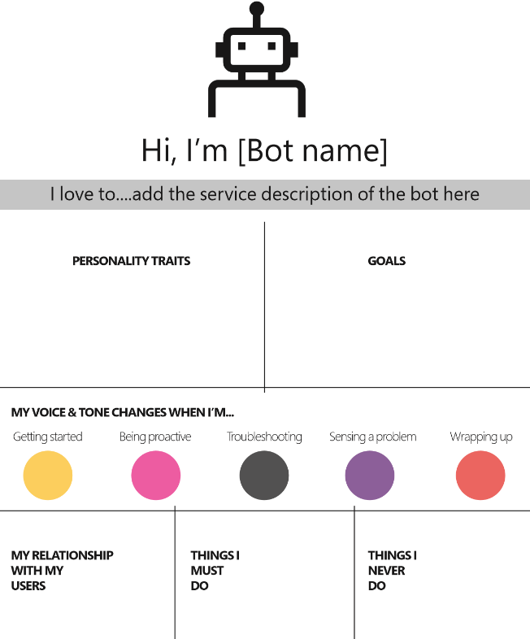
Define bot persona
It’s your brand….
Any bot is representing your brand, products and services to your end customers and employees
Therefore it’s imperative to take a design led approach to understand end users goals, the personality, tone of voice…

Slide 17
Plan
Build
Build
Comprehensive framework for the lifecycle of your project
Test
Publish
Connect
Evaluate
Notes:
<Enter> <Enter> <Enter>
Here’s a simple E2E development workflow .. You want to start building your bot by creating mockup conversations. These will help you validate your scenarios as well as build out a rough skeleton of the types of conversations your bot needs to support. This is the phase where key business decision makers can collaborate and or review the mocks and approve.
<Enter>
As I was saying earlier, your bot itself is made up of parts. There are bunch of different parts that you need to build and integrate to build a good bot.
Including Language Understanding, Dialog, AI services, User Experience, Infrastructure and your own business logic.
There are bunch of different services and tools available for you to build your bot parts.
<Enter>
That said, with Bot Builder V4, for the first time we are covering the E2E bot development workflow. You will have powerful tools that help plug into each phase of your development. You can build on top of the tools to suit your own development style and preferences.
With the new tools we are also introducing several new simple text file formats that work in conjunction with the tools.
Of course to build your bot and assemble all your bot parts together, we have a fantastic new Bot Builder SDK.

Slide 18
Bot Builder SDK
Bot Builder v3
Bot Builder v4
Current GA release
Open source
Strong momentum
300k+ developers
150k+ bots
C#, Node.js, samples, docs
In preview
Architected for extensibility
Modular
C#, JavaScript, Python, Java
Incorporates feedback from v3

Slide 19
Command line tools
Tools and file formats for building bots with Microsoft Bot Framework
MSBot
LuDown
LUIS
Az Bot
Manage your bot configuration file
Bootstrap language understanding
Manage your LUIS applications
Manage Azure Bot Services
# Connect to an Azure bot msbot connect azure […] # Connect to LUIS msbot connect luis […]
# Greeting - Hi - Hello - Good morning - Good evening # Help - help - I need help
# Import LUIS model luis import version # Train luis train version # Publish luis publish version
# Create a web app bot Az bot create –kind webapp –n “mybot” # Manage channel registration Az bot skype create Az bot msteams create Az bot directline create

Slide 20
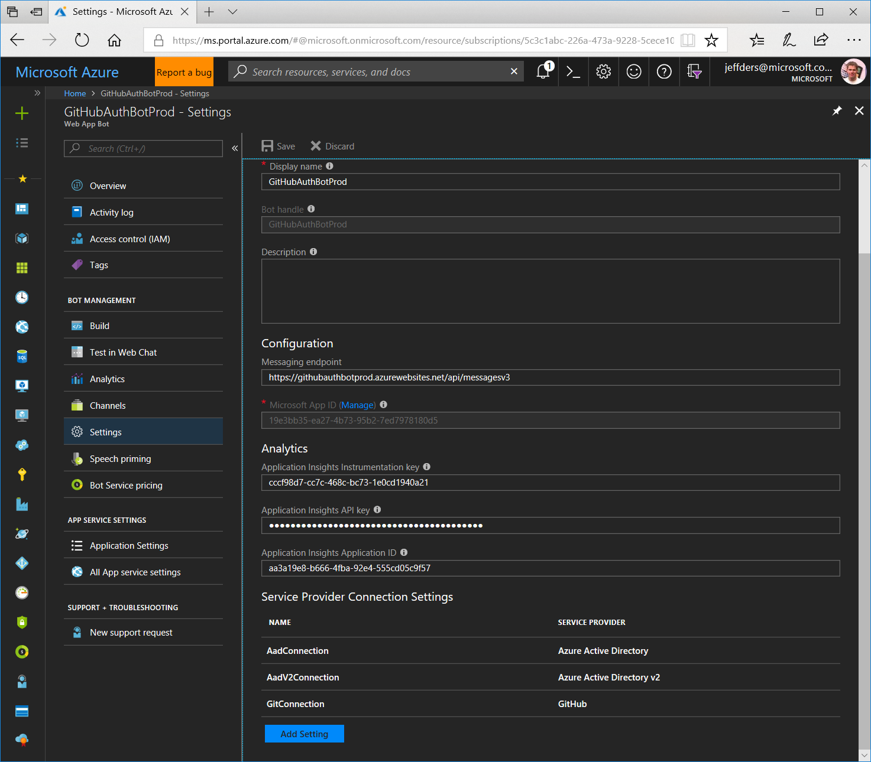
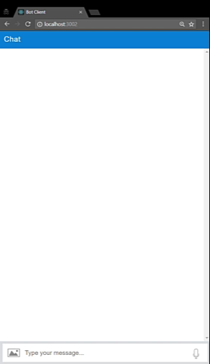
Authentication
Configure OAuth in Azure
Use OAuth in your bot

Slide 21
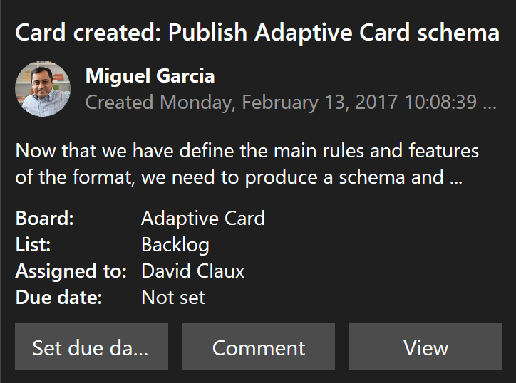
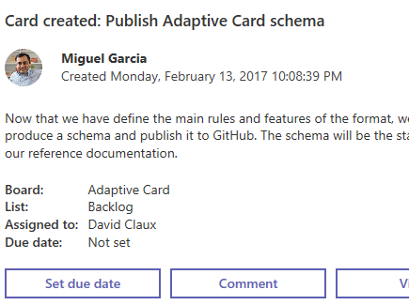
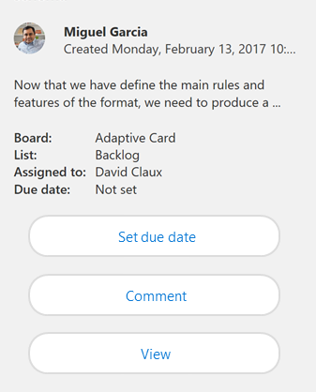
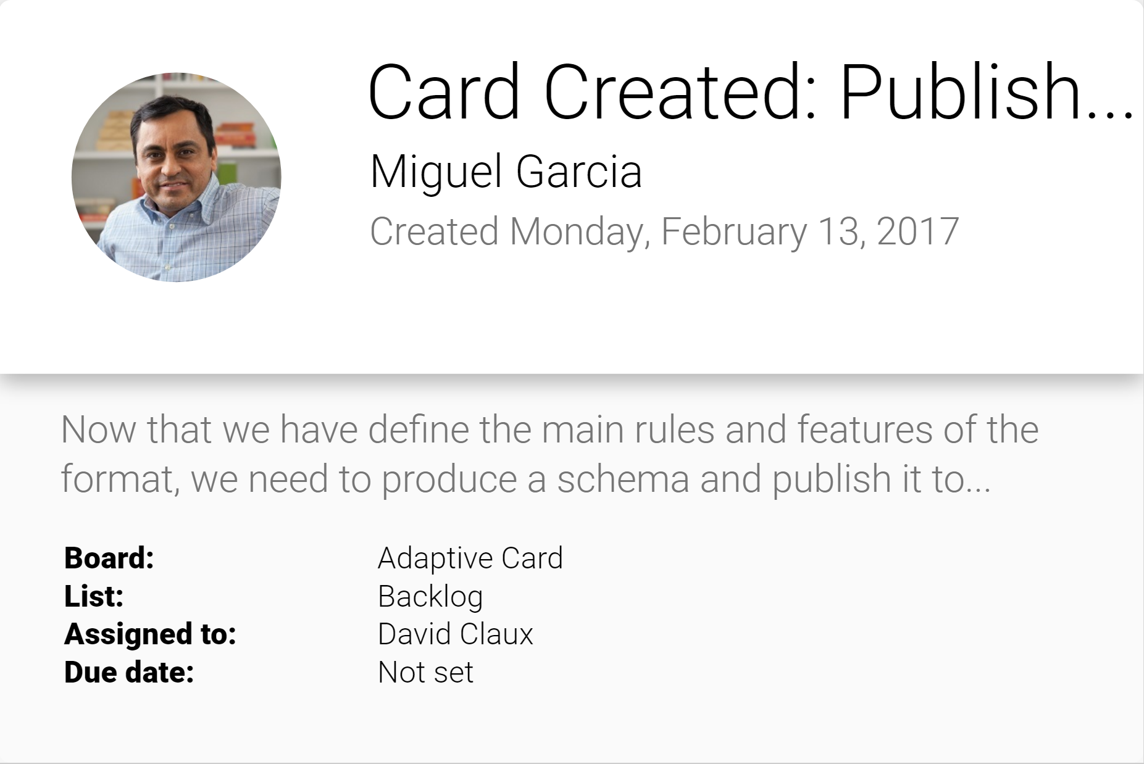
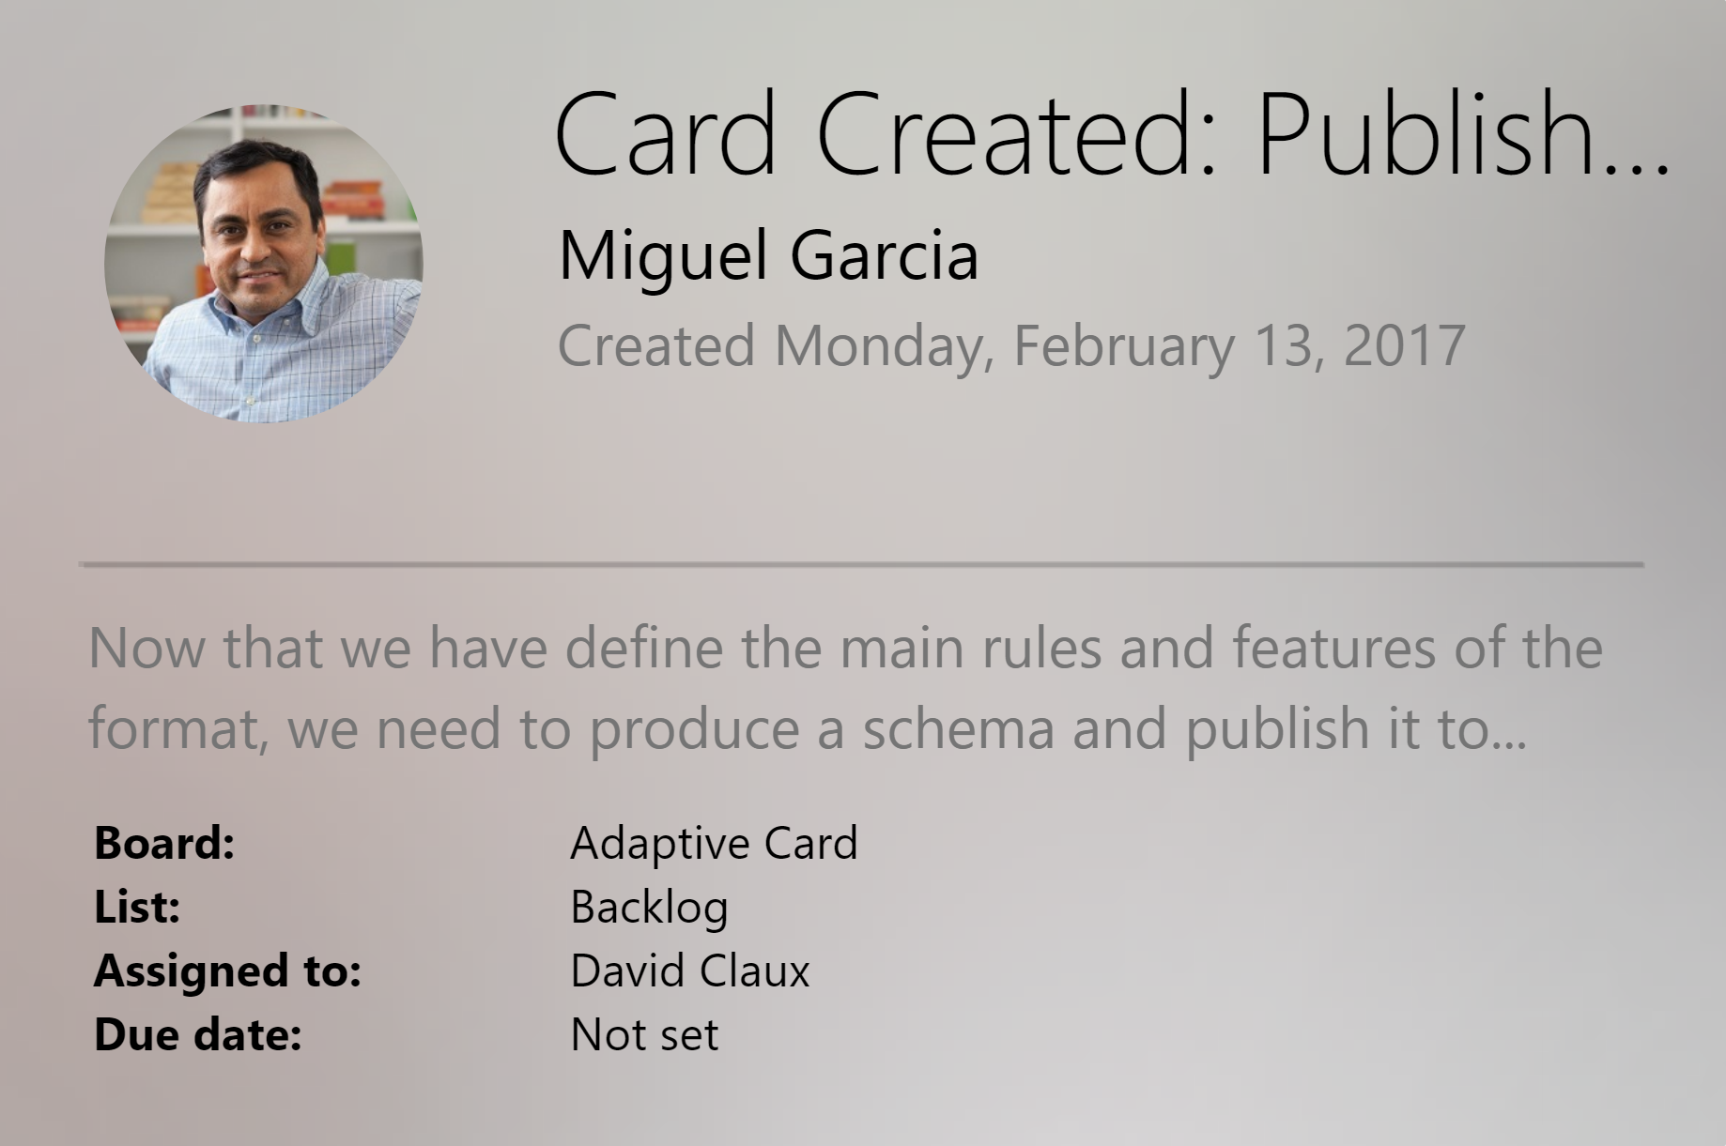
Adaptive cards
Open framework multiple canvases
Notification
Microsoft Teams
Skype
Android
iOS

Slide 22
Adding intelligence
Language understanding intelligent service
Teach your apps to understand commands from your users
Azure Search
Integrate search into a conversational experience
QnA Maker
Distill information into conversational, easy-to-navigate answers
Conversation Learner
Text goes here
Personality Chat
Text goes here
Bing Speech API
Convert speech to text and back again, and understand its intent
Speaker recognition API
Give your app the ability to know who's talking
Translator
Easily perform speech and text translation
Custom speech service
Fine-tune speech recognition for anyone, anywhere
Notes:
Speech APIs provide state-of-the-art algorithms to process spoken language powered by Bing. This also includes speech synthesis for a subset of languages supported by speech recognition. With these APIs developers can easily include the ability to add speech driven actions into their applications. In certain cases, the APIs allow for real-time interaction with the user as well. Additional capabilities include voice recognition and speaker identification as well as providing partial transcription, meaning that for supported languages the developer can get partial results before the user has finished speaking.
Bing Speech API: Convert audio to text, understand intent, and convert text back to speech for natural responsiveness. Converts spoken audio to text. Synthesize Speech - Synthesize audio from Text.
Custom Speech Service: Custom Speech Service (CRIS) enables you to create customized language models and acoustic models tailored to your application and your users. By uploading speech and/or text data to CRIS that reflects your application and your users, you can create custom models that can be used in conjunction with Microsoft’s existing state-of-the-art speech models. To customize the acoustic model to a particular domain, a collection of speech data is required. This collection consists of a set of audio files of speech data, and a text file of transcriptions of each audio file. The audio data should be representative of the scenario in which you would like to use the recognizer. If you were building an app to search MSDN by voice, it’s likely that terms like “object-oriented” or “namespace” or “dot net” will appear more frequently than in typical voice applications. Customizing the language model will enable the system to learn this. CRIS uses acoustic or language model adaptation to enable the speech recognizer to learn the characteristics of the customer’s data while still getting the benefits of all the data and expertise that went into creating the base models that power the Speech API.
For acoustic model adaptation, the technology is described in this paper: http://research.microsoft.com/pubs/194346/0007893.pdf
Works well when the data is uploaded to CRIS is truly representative of the user population and the expected usage of the application. For language model adaptation, it works best when the data uploaded reflects what people would actually say. Uploading simply a list of new terms is better than nothing but will not be as effective. For acoustic model adaptation, if you want to adapt to elderly speech, you need to upload the speech from many different elderly users, not just one or two. If you upload just one person’s voice, CRIS will learn to do a great job on that voice but will not necessarily learn to generalize to other elderly voices. Similarly, if you want to adapt to a new environment, like a factory, you should upload speech data from many speakers in the factory, not just one.
Speaker Recognition API: Microsoft's state-of-the-art cloud-based speaker recognition algorithms to recognize a human's voice in audio streams. It comprises two components: speaker verification and speaker identification. Speaker Verification can automatically verify and authenticate users from their voice or speech. It is tightly related to authentication scenarios and is often associated with a pass phrase. Hence, we opt for text-dependent approach, which means speakers need to choose a specific pass phrase to use during both enrollment and verification phases. Speaker Identification can automatically identify the person speaking in an audio file given a group of prospective speakers. The input audio is paired against the provided group of speakers, and in case there is a match found, the speaker’s identity is returned. It is text-independent, which means that there are no restrictions on what the speaker says during the enrollment and recognition phases. A use case is biometric authentication using voice.

Slide 23


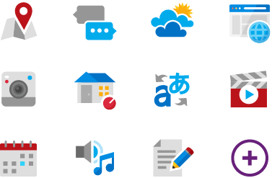
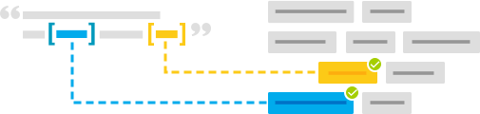
Language Understanding (LUIS)
Machine learning-based service to build natural language into apps, bots, and IoT devices. Quickly create enterprise-ready, custom models that continuously improve
Add natural language to your apps
Quickly build a custom language solution
Always learning and improving
Enterprise- ready, available worldwide

Slide 24
New features
Integrated experience
Enterprise-grade service
Core language understanding
Speech. Speech priming now happens automatically when the LUIS app is published. A single key works for LUIS & speech
Sentiment. Sentiment analysis, commonly known as Text Analytics Cognitive Service, is now included as part of LUIS. This is included at no additional charge
Multi-lingual. Build your LUIS application in one language, and Machine Translation is used enable the bot to work with multiple languages
GA service. GA since December 2017, with SLAs, multiple pricing tiers
GDPR, ISO, & HIPAA compliance
12 languages & 13 Azure regions
Patterns. Patterns are templates that teach LUIS common utterances with fewer examples. It is fully integrated with machine learning
Regex entity. Identifies an entity in the utterance based on a regular expression
Key phrase entity. Identifies noun phrases in the utterance using the Cognitive Services Text Analytics APIs

Slide 25
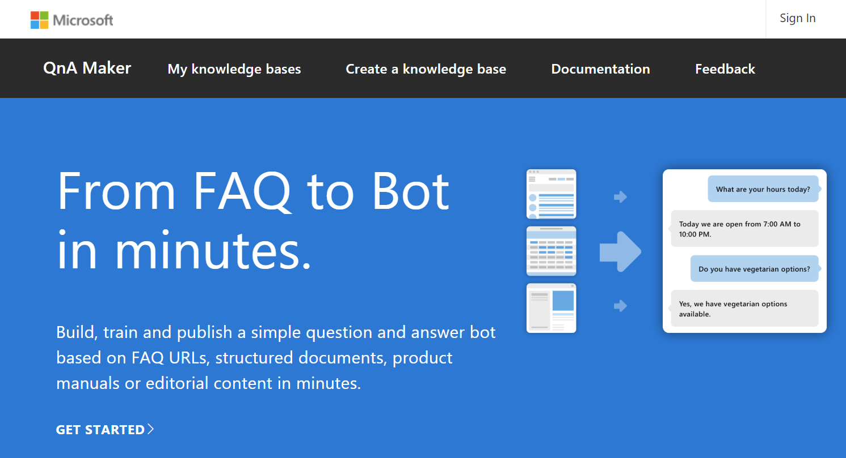
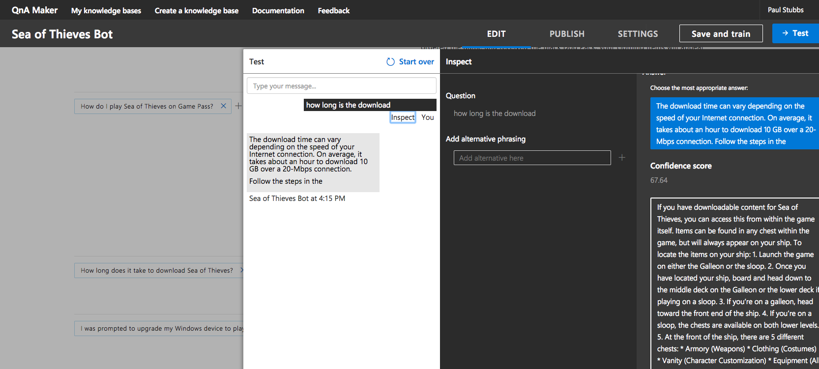
QnA Maker
Announcing general availability!
New architecture. The data and runtime hosted in your Azure subscription
No more throttling!
Data privacy and compliance. QnA data is hosted within your Azure compliance boundary
Azure Application Insights integration
Notes:
https://QnAMaker.ai
GA Announcement
https://blog.botframework.com/2018/05/07/announcing-general-availability-of-qnamaker/

Slide 26
Demo
QnA Maker

Slide 27
Conversation Learner
AI-first way of building a task-oriented bot
Express business rules and common sense in code
End-to-end recurrent neural network
Learns directly from multi-turn examples of conversations
Enables designers, business owners, domain experts to contribute/maintain bot
Bot output is structured as templates (text, cards)
Easy to add constraints to limit which actions are available
Call domain-specific APIs
Add code to resolve and manipulate entities
“Code what’s easy to code; learn what’s easy to learn”

Slide 28

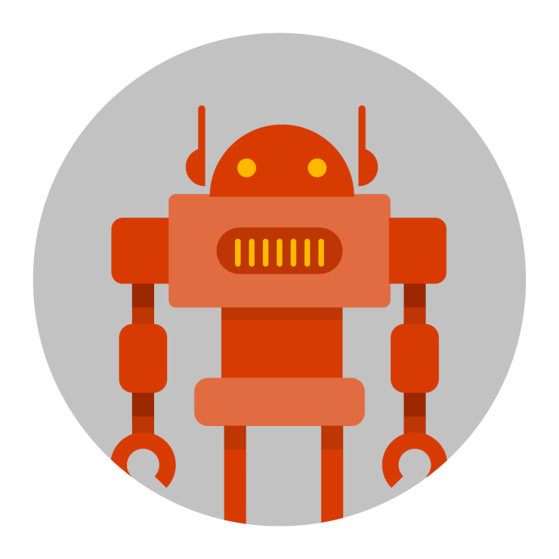
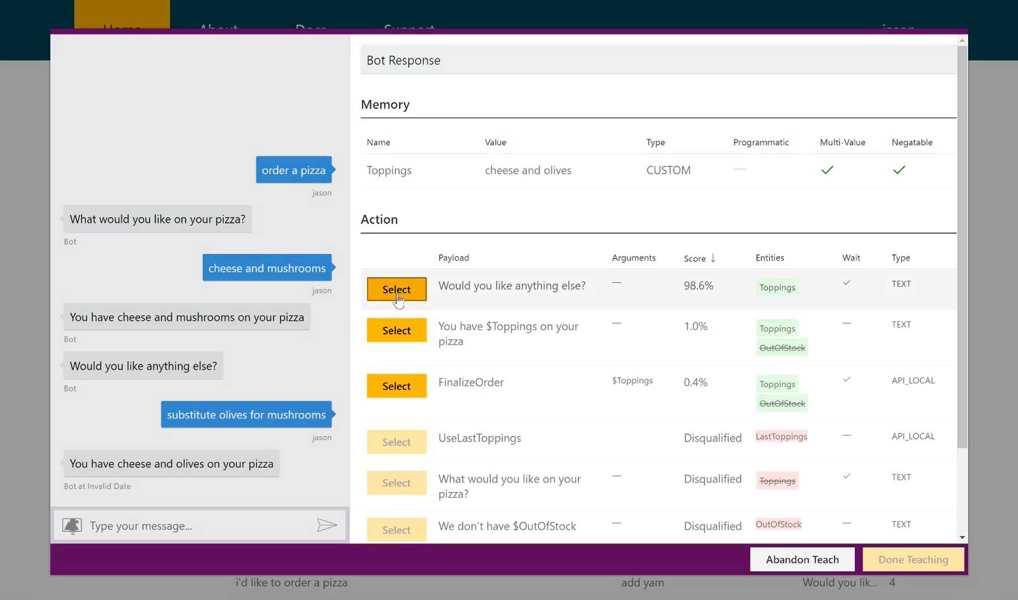



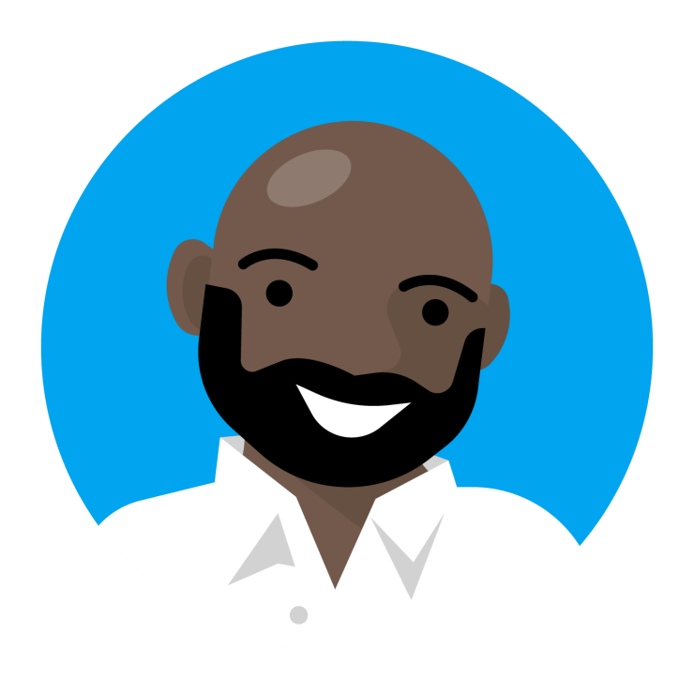
Conversation Learner workflow
Nothing
Interactive teaching
Developer plays role of user
Bot
Conversation Learner UI
Developer makes corrections
Something
Make corrections to logged dialogs
End users
Bot
Conversation Learner UI
Developer makes corrections
Good!

Slide 29
Demo
Conversation Learner

Slide 30
Project personality chat
Enhances your bot's conversational capabilities, by handling small talk, in line with a distinct chosen personality
Uses intent classifiers to identify common small talk intents and generates responses consistent with the personality
Based on the intent and the confidence scores, it chooses the best response from a curated editorial base or generates it real-time using Deep Neural Networks (DNNs)
Notes:
Demo: https://labs.cognitive.microsoft.com/en-us/project-personality-chat

Slide 31
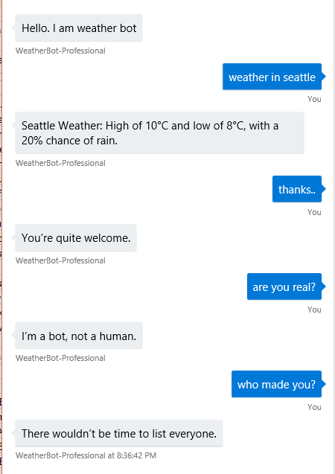
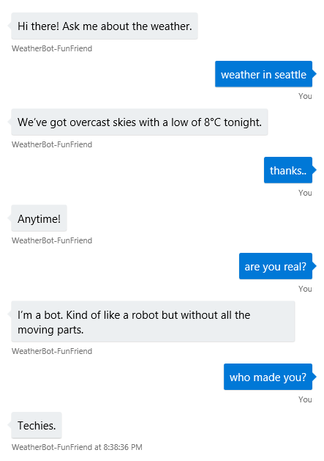
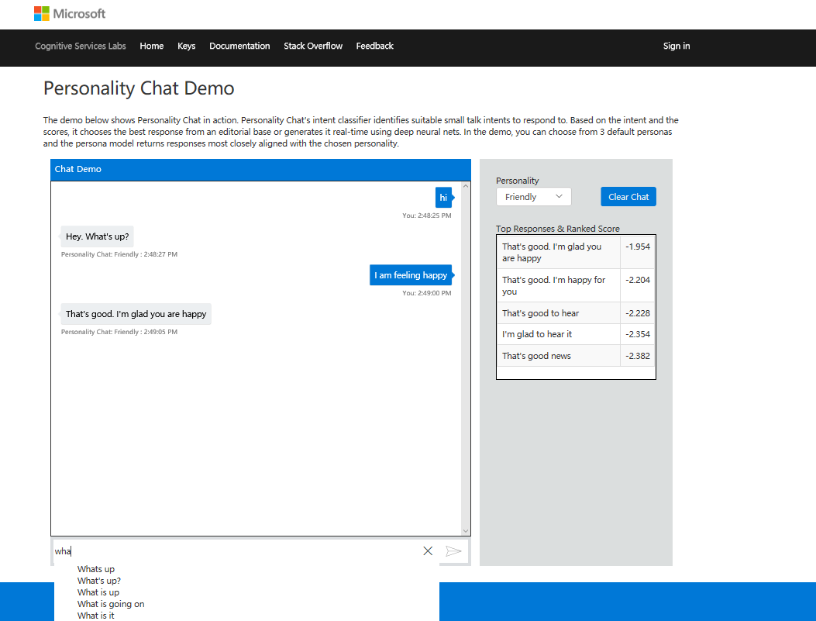
Bot personality
Professional
Friendly
Notes:
This is one of the typical types of bots that you see built today.
It cannot handle any small talk or deviations unless specifically programmed by the developer.

Slide 32
Demo
Personality Chat

Slide 33
Plan
Build
Test
Comprehensive framework for the lifecycle of your project
Test
Publish
Connect
Evaluate
Notes:
<Enter> <Enter> <Enter>
Here’s a simple E2E development workflow .. You want to start building your bot by creating mockup conversations. These will help you validate your scenarios as well as build out a rough skeleton of the types of conversations your bot needs to support. This is the phase where key business decision makers can collaborate and or review the mocks and approve.
<Enter>
As I was saying earlier, your bot itself is made up of parts. There are bunch of different parts that you need to build and integrate to build a good bot.
Including Language Understanding, Dialog, AI services, User Experience, Infrastructure and your own business logic.
There are bunch of different services and tools available for you to build your bot parts.
<Enter>
That said, with Bot Builder V4, for the first time we are covering the E2E bot development workflow. You will have powerful tools that help plug into each phase of your development. You can build on top of the tools to suit your own development style and preferences.
With the new tools we are also introducing several new simple text file formats that work in conjunction with the tools.
Of course to build your bot and assemble all your bot parts together, we have a fantastic new Bot Builder SDK.

Slide 34
Plan
Build
Publish
Comprehensive framework for the lifecycle of your project
Test
Publish
Connect
Evaluate
Notes:
<Enter> <Enter> <Enter>
Here’s a simple E2E development workflow .. You want to start building your bot by creating mockup conversations. These will help you validate your scenarios as well as build out a rough skeleton of the types of conversations your bot needs to support. This is the phase where key business decision makers can collaborate and or review the mocks and approve.
<Enter>
As I was saying earlier, your bot itself is made up of parts. There are bunch of different parts that you need to build and integrate to build a good bot.
Including Language Understanding, Dialog, AI services, User Experience, Infrastructure and your own business logic.
There are bunch of different services and tools available for you to build your bot parts.
<Enter>
That said, with Bot Builder V4, for the first time we are covering the E2E bot development workflow. You will have powerful tools that help plug into each phase of your development. You can build on top of the tools to suit your own development style and preferences.
With the new tools we are also introducing several new simple text file formats that work in conjunction with the tools.
Of course to build your bot and assemble all your bot parts together, we have a fantastic new Bot Builder SDK.

Slide 35
Plan
Build
Connect
Comprehensive framework for the lifecycle of your project
Test
Publish
Connect
Evaluate
Notes:
<Enter> <Enter> <Enter>
Here’s a simple E2E development workflow .. You want to start building your bot by creating mockup conversations. These will help you validate your scenarios as well as build out a rough skeleton of the types of conversations your bot needs to support. This is the phase where key business decision makers can collaborate and or review the mocks and approve.
<Enter>
As I was saying earlier, your bot itself is made up of parts. There are bunch of different parts that you need to build and integrate to build a good bot.
Including Language Understanding, Dialog, AI services, User Experience, Infrastructure and your own business logic.
There are bunch of different services and tools available for you to build your bot parts.
<Enter>
That said, with Bot Builder V4, for the first time we are covering the E2E bot development workflow. You will have powerful tools that help plug into each phase of your development. You can build on top of the tools to suit your own development style and preferences.
With the new tools we are also introducing several new simple text file formats that work in conjunction with the tools.
Of course to build your bot and assemble all your bot parts together, we have a fantastic new Bot Builder SDK.

Slide 36
Plan
Build
Connect
Comprehensive framework for the lifecycle of your project
Test
Publish
Connect
Evaluate
Notes:
<Enter> <Enter> <Enter>
Here’s a simple E2E development workflow .. You want to start building your bot by creating mockup conversations. These will help you validate your scenarios as well as build out a rough skeleton of the types of conversations your bot needs to support. This is the phase where key business decision makers can collaborate and or review the mocks and approve.
<Enter>
As I was saying earlier, your bot itself is made up of parts. There are bunch of different parts that you need to build and integrate to build a good bot.
Including Language Understanding, Dialog, AI services, User Experience, Infrastructure and your own business logic.
There are bunch of different services and tools available for you to build your bot parts.
<Enter>
That said, with Bot Builder V4, for the first time we are covering the E2E bot development workflow. You will have powerful tools that help plug into each phase of your development. You can build on top of the tools to suit your own development style and preferences.
With the new tools we are also introducing several new simple text file formats that work in conjunction with the tools.
Of course to build your bot and assemble all your bot parts together, we have a fantastic new Bot Builder SDK.

Slide 37
How to evaluate and iterate? Evaluate
Plan
1
Iterate with feedback is key: get to users fast; start simple
Build
Test
2
Focus on business KPI and leverage custom dashboard
Publish
3
Build evaluation into process and gain business insights from bot
Connect
Evaluate
Notes:
These are the 3 best practices for the evaluation phase that we think are important:
1）feedback is critically important to improve a conversational experience. Your user will tell you how they would converse with your bot, so the sooner you get the bot to users, the faster you can leverage user conversation to help your bot to get smarter and address user need better.
This means you do not need a sophisticated analytics solution to be able to evaluate and refine a bot. At the minimum, you should start simple by using the out of box tool we’ve provided in Azure bot service and language understanding service for evaluation.
You don’t need custom dashboard before you get the bot out for preview.

Slide 38
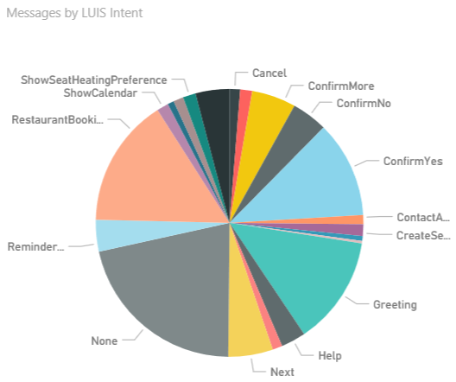
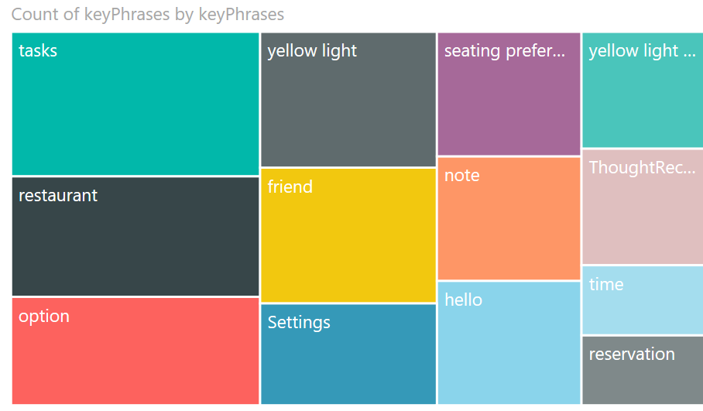
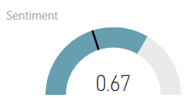
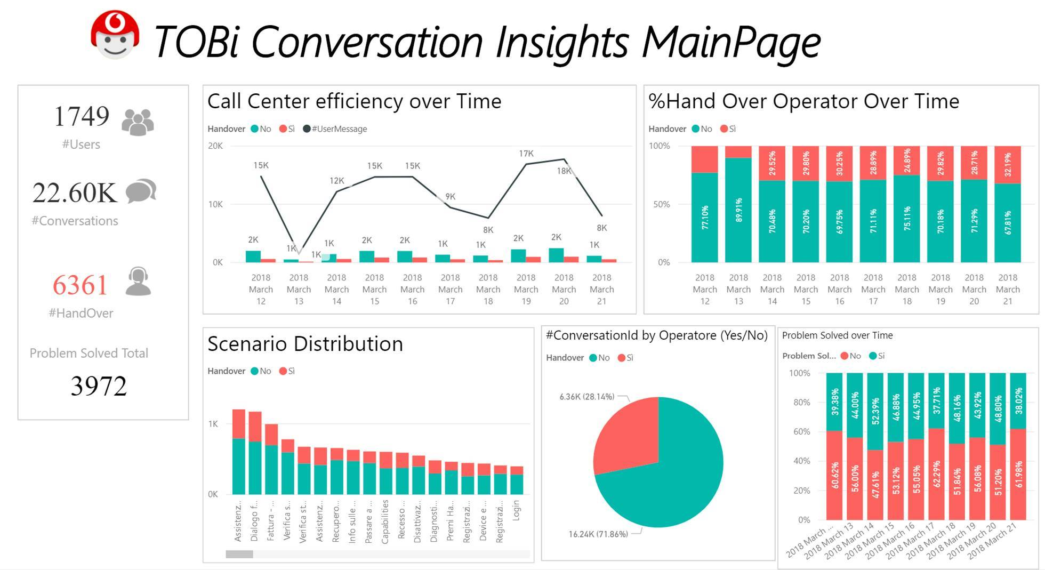
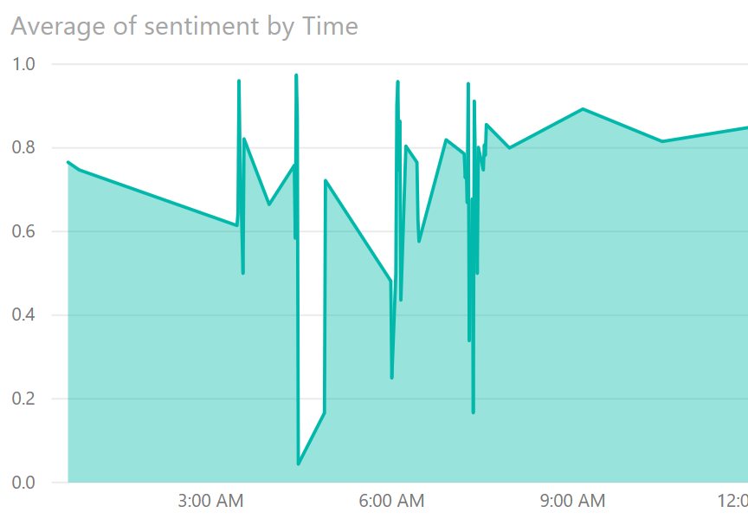
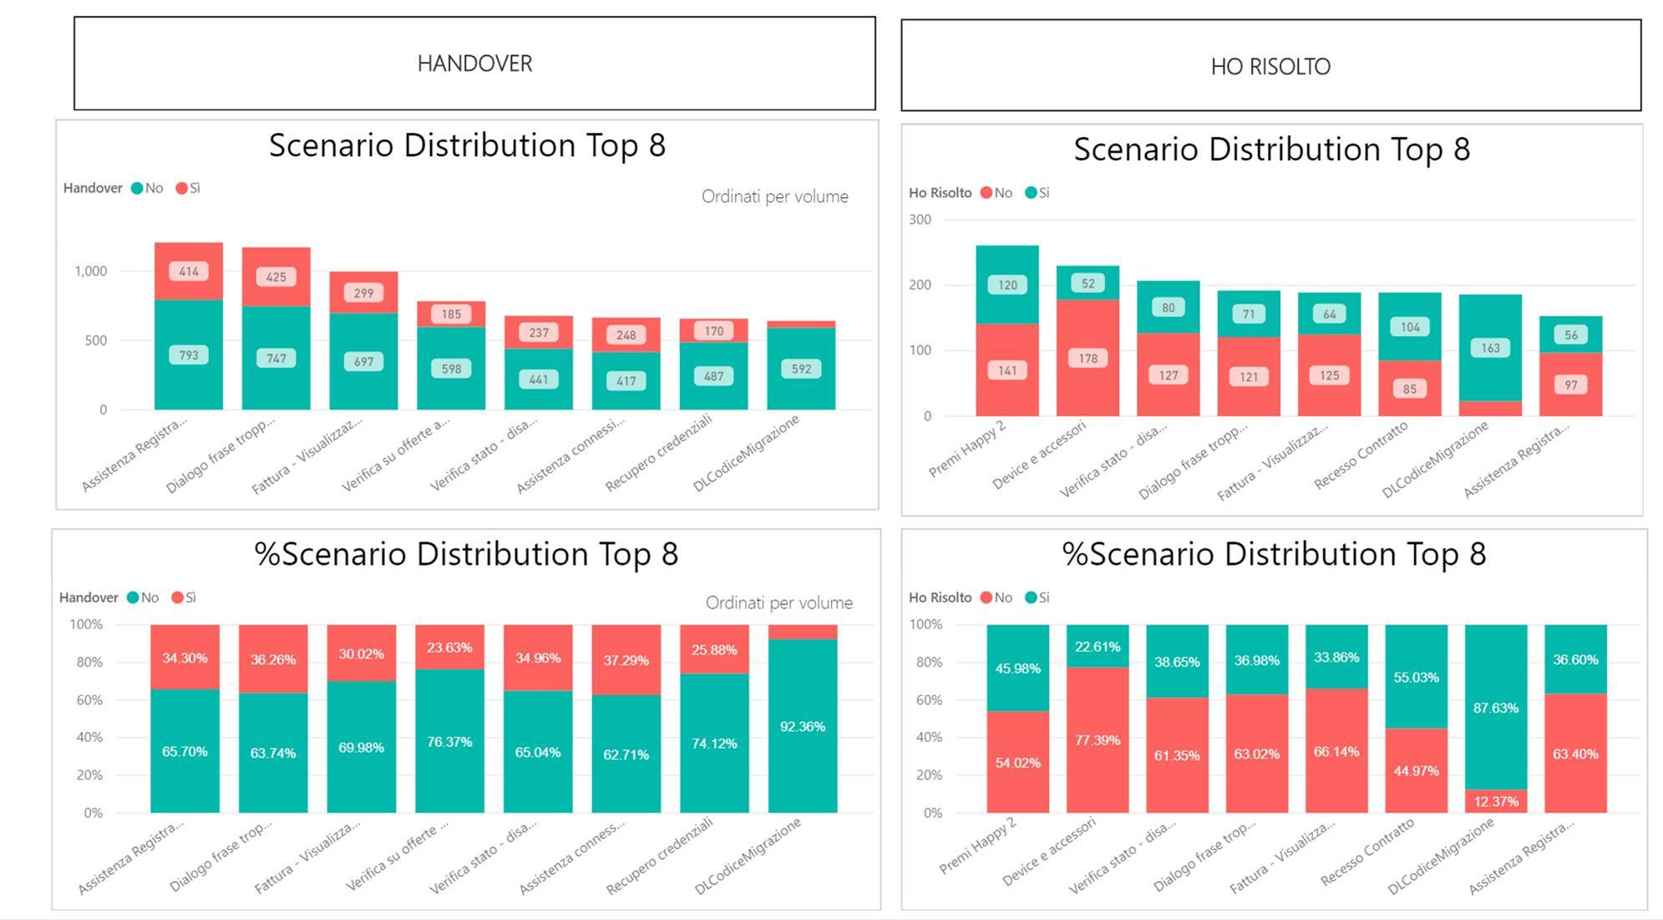
Business intelligence
Intent metrics
Sentiment analysis
Handover rate
Conversion rate
Abandonment rate
Notes:
White and his colleagues consider the Microsoft tools’ accessibility and ease of use to be invaluable, particularly when updating existing dialogue models. “Our level of speed and agility would be very difficult to replicate with other tools,” says White. “In the first four months since launching the Flo Chatbot, we’ve updated the models at least 75 times. By using the Microsoft tools, we’re ensuring constant improvement and a better customer experience.”
Interactions with the Flo Chatbot show Progressive that the bot is a hit with customers. “People tell Flo ‘Thank you’ and ‘Thanks for the help,’ and I think that any time you see people thanking a bot, you’re on the right track,” says White. “And, of course, we trained the Flo Chatbot to say, ‘You’re welcome,’ because we want to continue that humanlike interaction right up to the end of the conversation.”
Once Cami goes live, Dixons Carphone expects the bot to be a new source of business intelligence. The company will use the Cognitive Services Text Analytics API, Microsoft Azure Application Insights, and a Microsoft Power BI dashboard to view levels of customer engagement, which products they are looking at, the sentiment of their interactions, and the questions they are asking. “We’ll get better analytics, so we’ll understand our customers better,” says Colin-Jones. “With Power BI and Application Insights, we’ll be able to see if customers are asking the same questions again and again, and that will help us improve our communications and messaging. We can then adjust Cami’s responses to build on her knowledge to improve customers’ experience with her. Seeing what questions customers are asking will also inform our future decision making about what functionality we might want to add to Cami. It’s been fascinating to learn what bots can do, and I'm excited to see how we can use this technology to transform our business.”

Slide 39
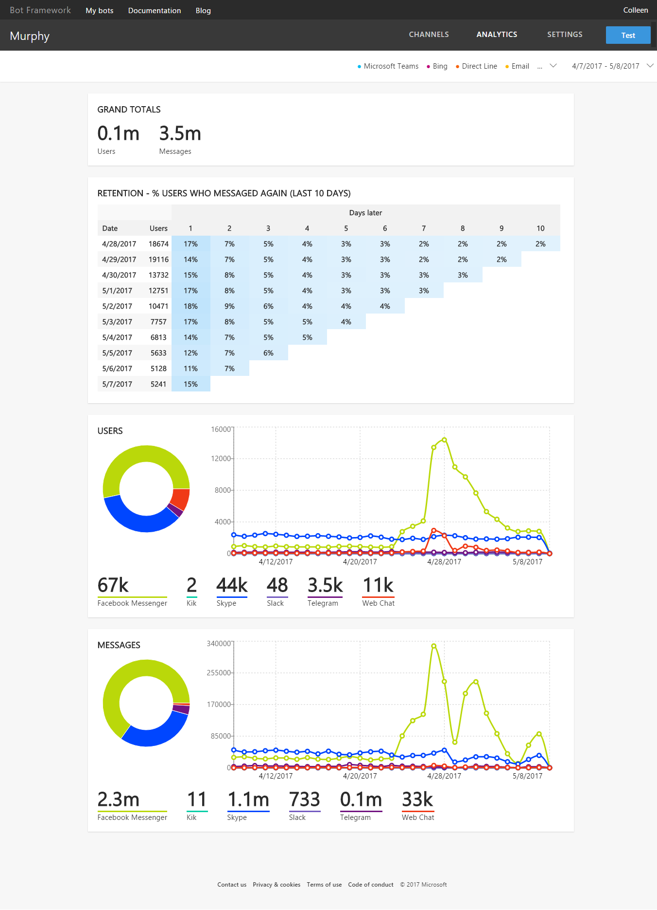
Bot analytics

Slide 40
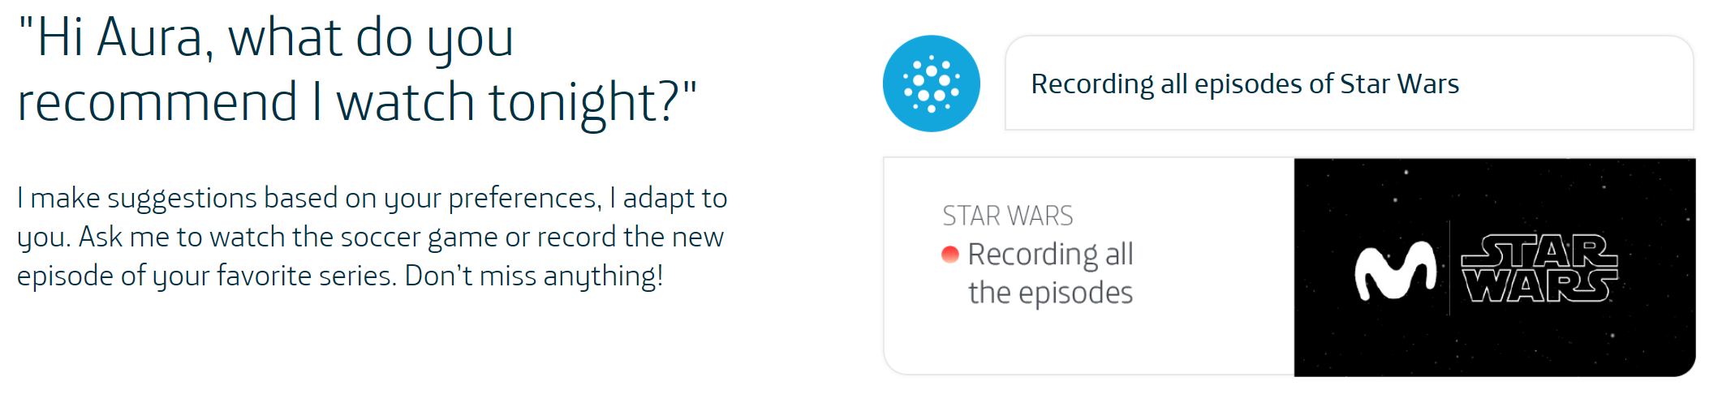
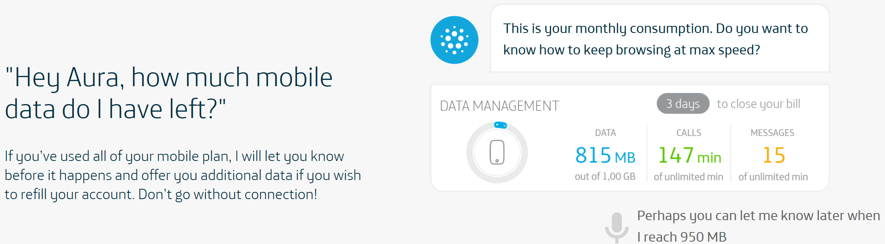
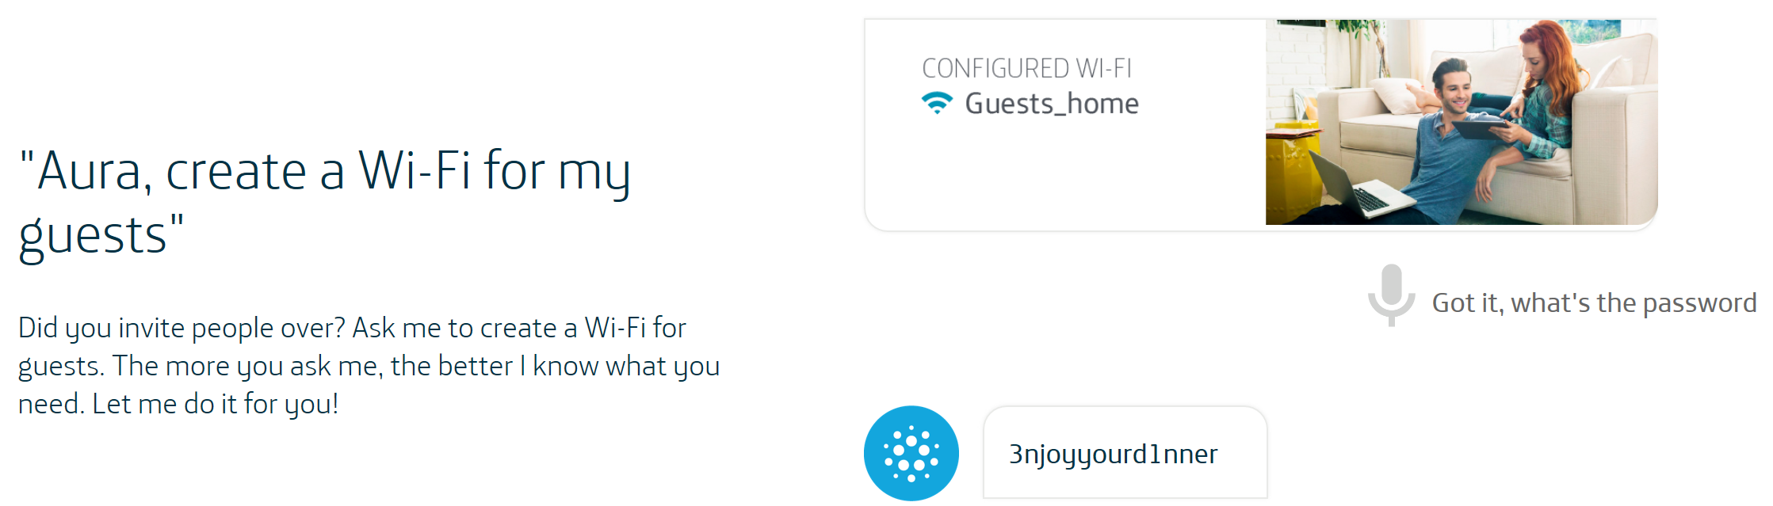
Telefonica AURA

Slide 41
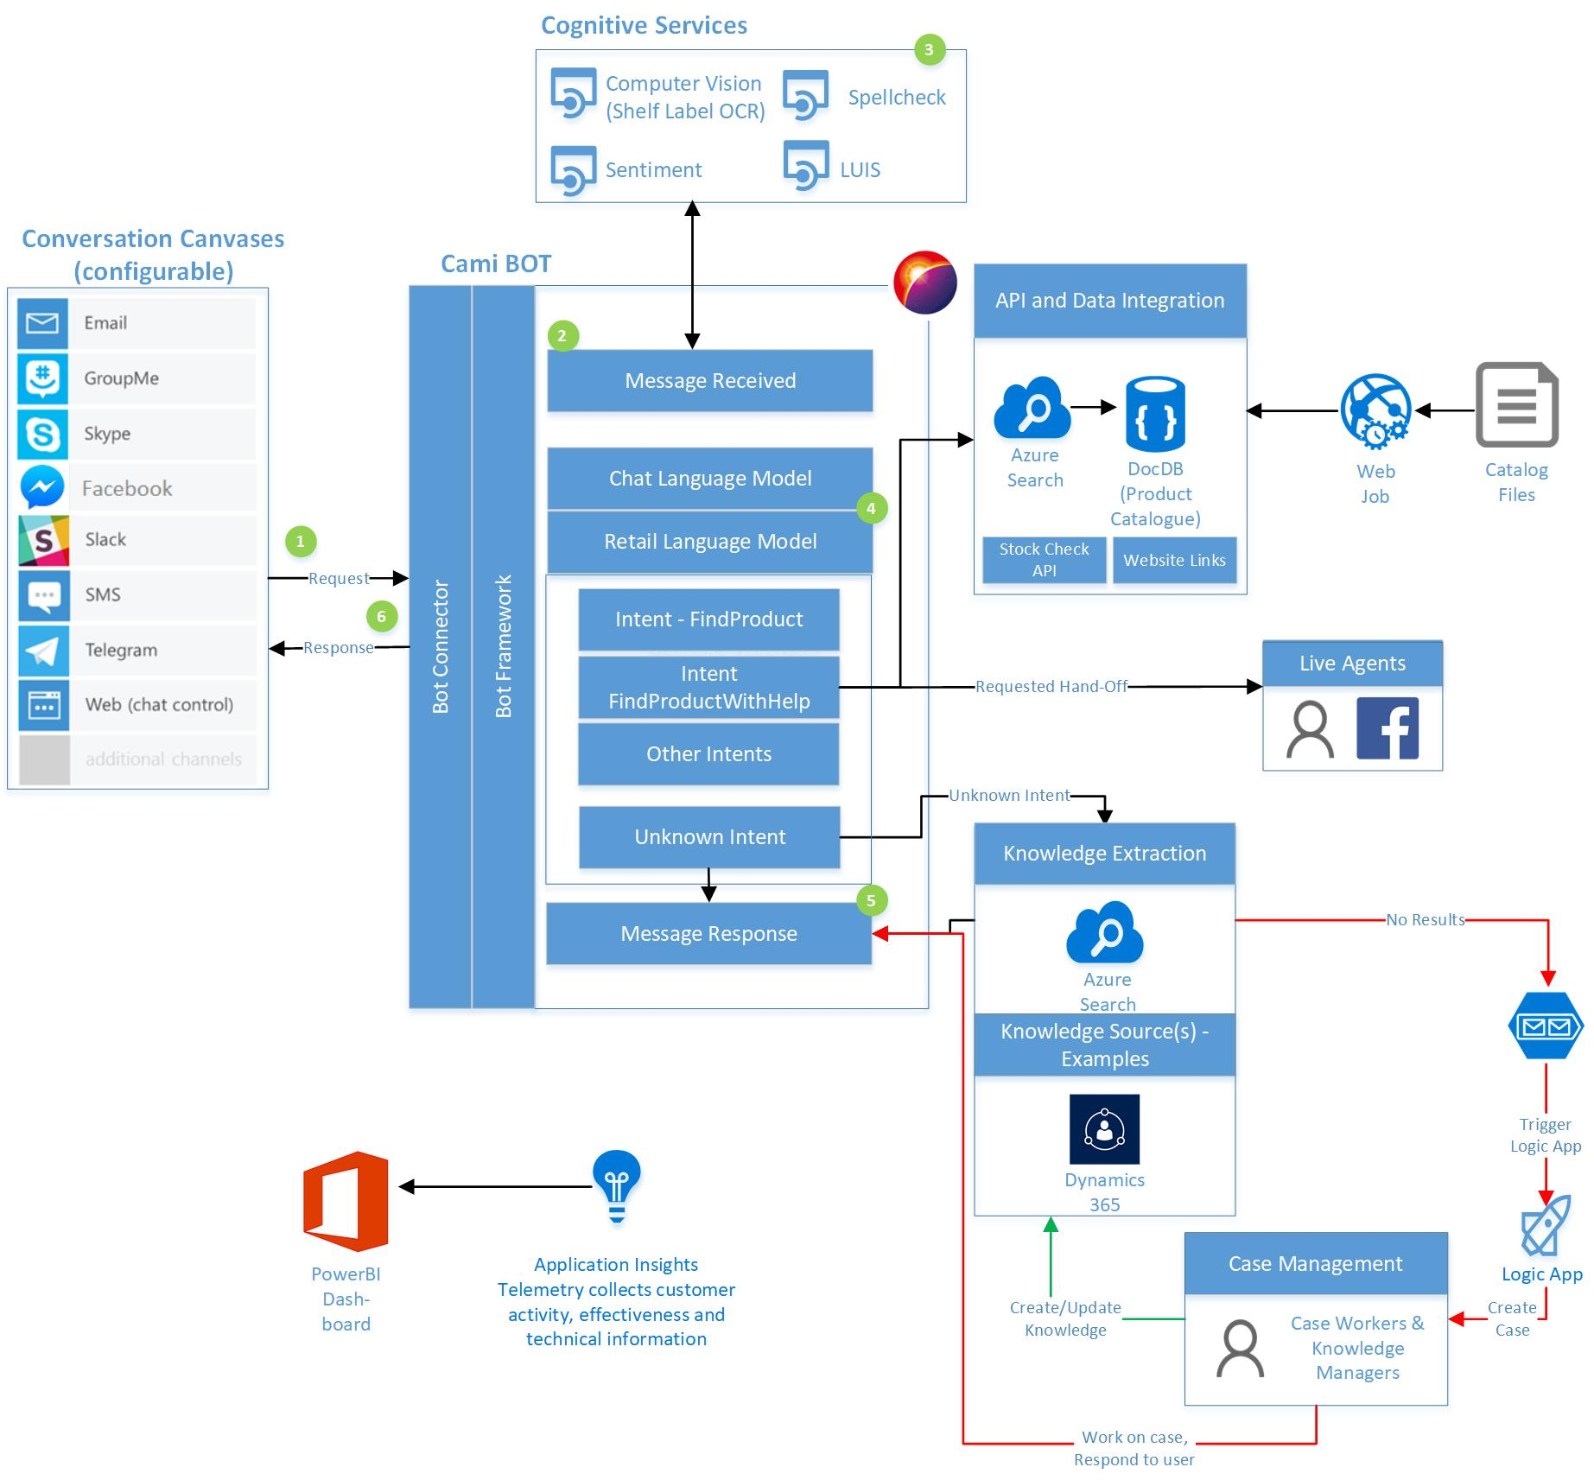
Dixons Carphone
A bot that interacts with customers online
Integrate with “wish-list” feature and hand off to humans when needed
Seamless online and in-store experience
Notes:
A bot that interacts with customers online before they come into electronics stores that includes complete inventory, including pictures and product specifications
The company’s numerous brands include Currys PC World, Carphone Warehouse, Dixons Travel, Team Knowhow, and Elkjøp in the Nordic countries.
42,000 employees in 11 countries

Slide 42
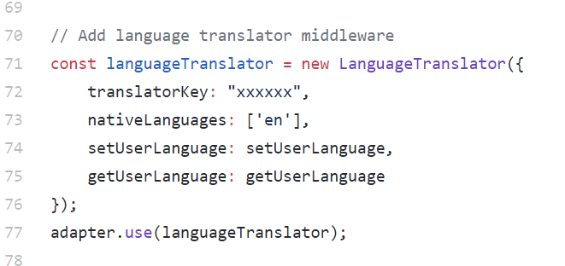
Extensible
Middleware extends bot’s environment and behavior
Uniform concept across platforms
Annotating/processing/transforming activities
Adding Machine Translation
Standard Middleware Calling Pattern
Request
Middleware 1
// logic
Next();
//more logic
Middleware 2
// logic
Next();
//more logic
Middleware 3
// logic
//more logic
Response

Slide 43
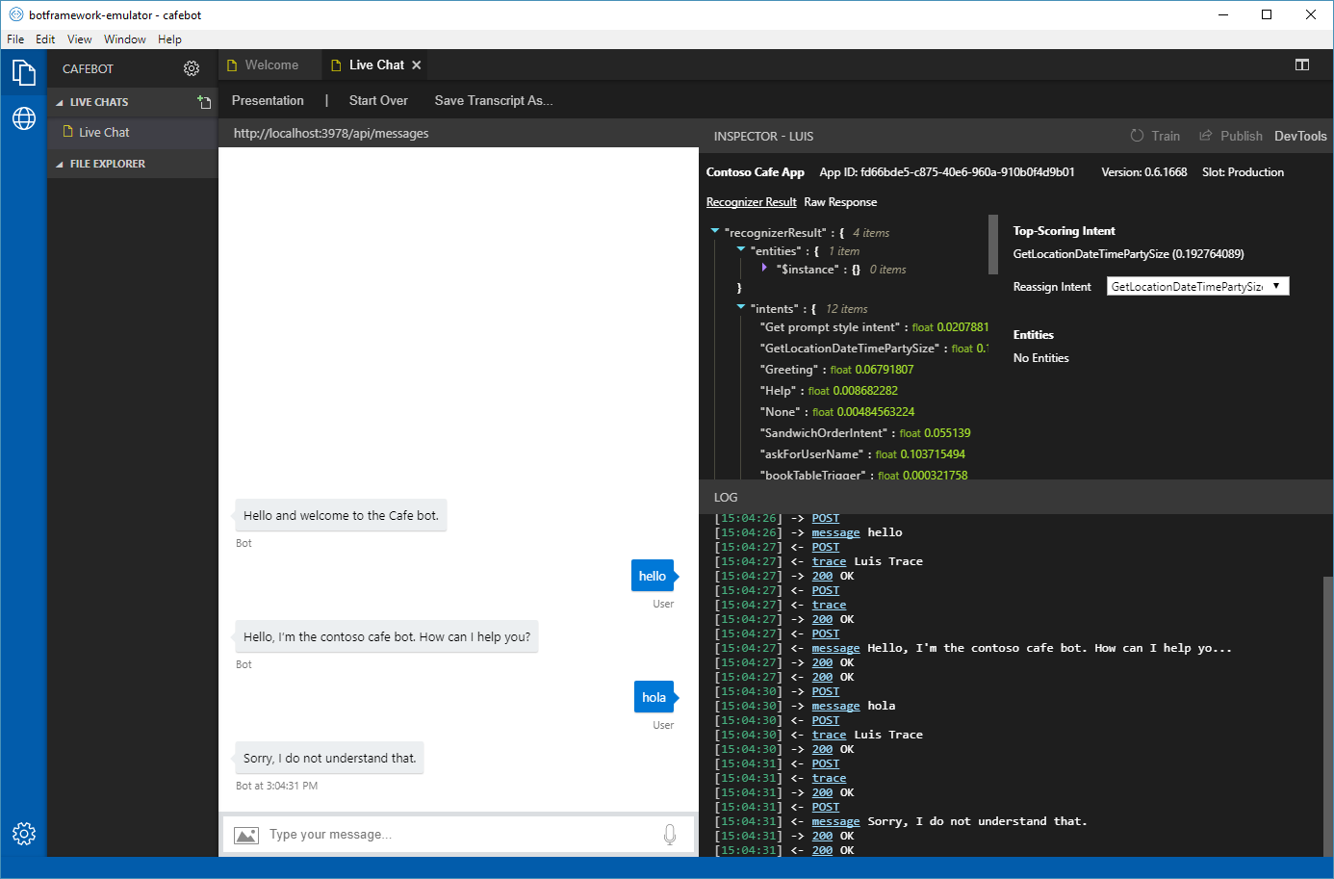
Bot framework emulator
Extensible plugins for working with services in context of chat

Slide 44
Dispatcher (Preview)
Bot components
Find conflicts and overlap
Language model
LUIS
Dispatch model
Evaluate and improve
QnA
Custom model
Dispatcher
Bot components
LUIS
Utterance
Dispatch
Bot logic
Answer,
Intent
QnA
Other
Response
Bot runtime

Slide 45
Call to action
Get started
azure.com/bots
Documentation
docs.microsoft.com/azure/bot-service
GitHub
github.com/microsoft/botbuilder-dotnet
Learn
aischool.microsoft.com

Slide 46
What next?
Bot Builder V4 (preview)
Get started today: aka.ms/BotBuilderOverview
Local: aka.ms/BotBuilderLocalDev
AZ CLI: aka.ms/BotBuilderAZCLI
Give us feedback, report issues: aka.ms/BotBuilderIssues
Language understanding
Get started today: aka.ms/LUIS
Bot partners
Join AI Partner Inner Circle Program: http://aipartner.microsoft.com
AI labs
Conversation Learner: aka.ms/TBD
Personality Chat: aka.ms/TBD
Azure Bot Service
Get started today: aka.ms/botservice
Ask anything on Stack Overflow: aka.ms/botframeworkSOF
Report issues and feature asks: aka.ms/ABSUserVoice
Cognitive Services
Get started today: aka.ms/AIServices
Notes:
Try BF SDK V4 preview
Give us
https://stackoverflow.com/questions/tagged/botframework
Bot Builder Tools repo - https://aka.ms/bbtools
Tools E2E walkthrough topics
Starting local with vsix/ yeoman/ dotnet new - https://aka.ms/BotBuilderLocalDev
Starting with AZ CLI - https://aka.ms/BotBuilderAZCLI
Starting with Ibiza portal - https://aka.ms/BotBuilderIbiza
New overview landing page - https://aka.ms/BotBuilderOverview

Slide 47
Bot framework roadmap 2017
Bot controls++
Bot builder
Speech support
Ecosystem integrations
(Flow, PowerApps, ++)
SDK V.Next
Bot brain
GA
Localization
Protocols & services & channels
Analytics++
Adaptive cards
Bot federation
Compliance
GA
Regions++, Channels++
May
Aug
Nov
Regions++, Languages++, Domains++
ML dialogs
Bot intelligence
Prebuilt domains
Multi-developer
Faster training
Speech services++
Pattern support
GA
Azure Bot Service v2
Sneak peak
Preview

Slide 48
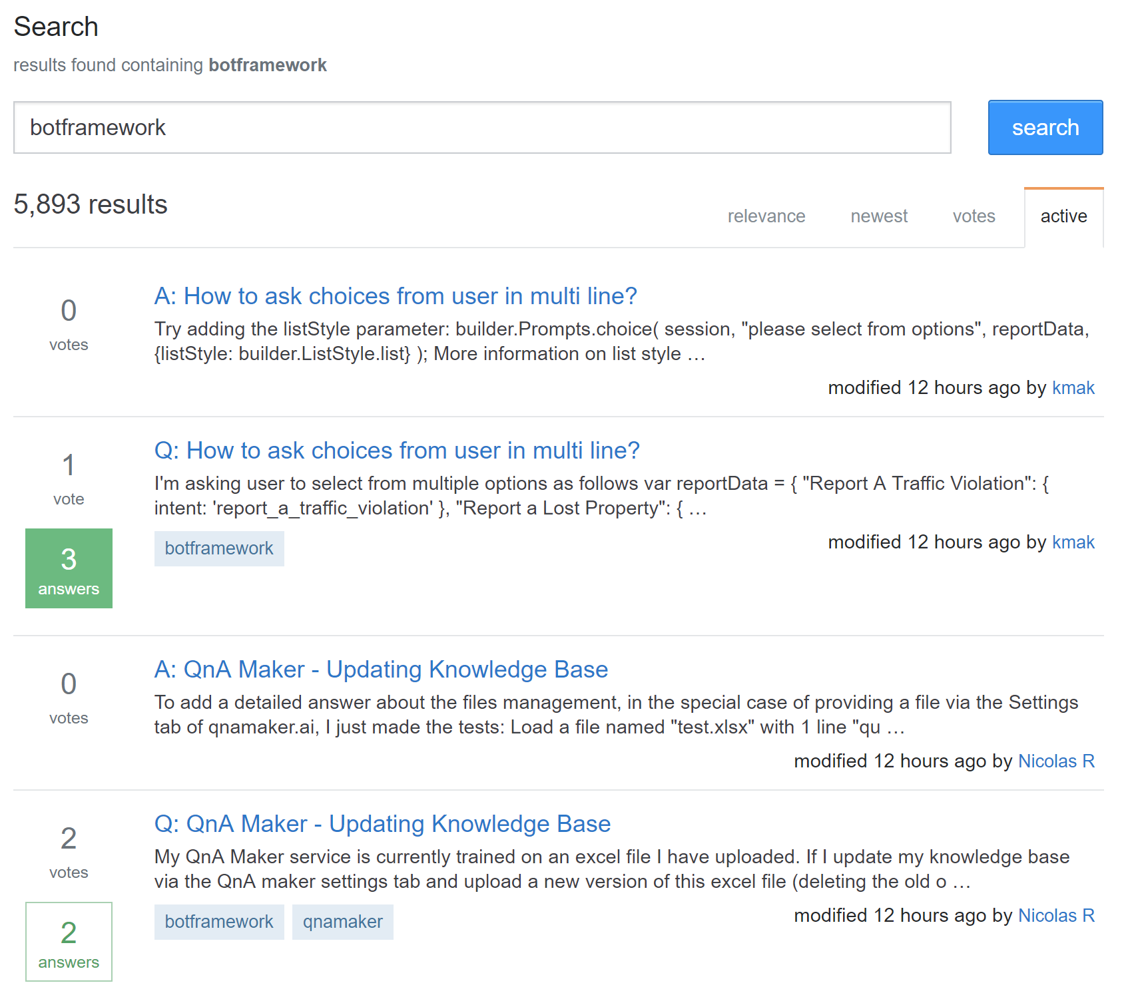
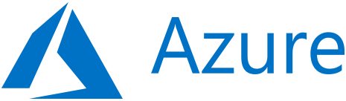

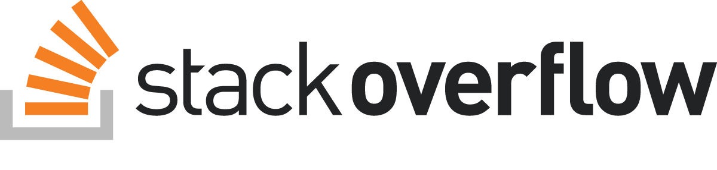

Support
Multiple technical support paths
Professional support
Community support

